Slide 1
Sardis
Revelation 3:1-6
Wallace, Steven J. www.revelationandcreation.com

Slide 2
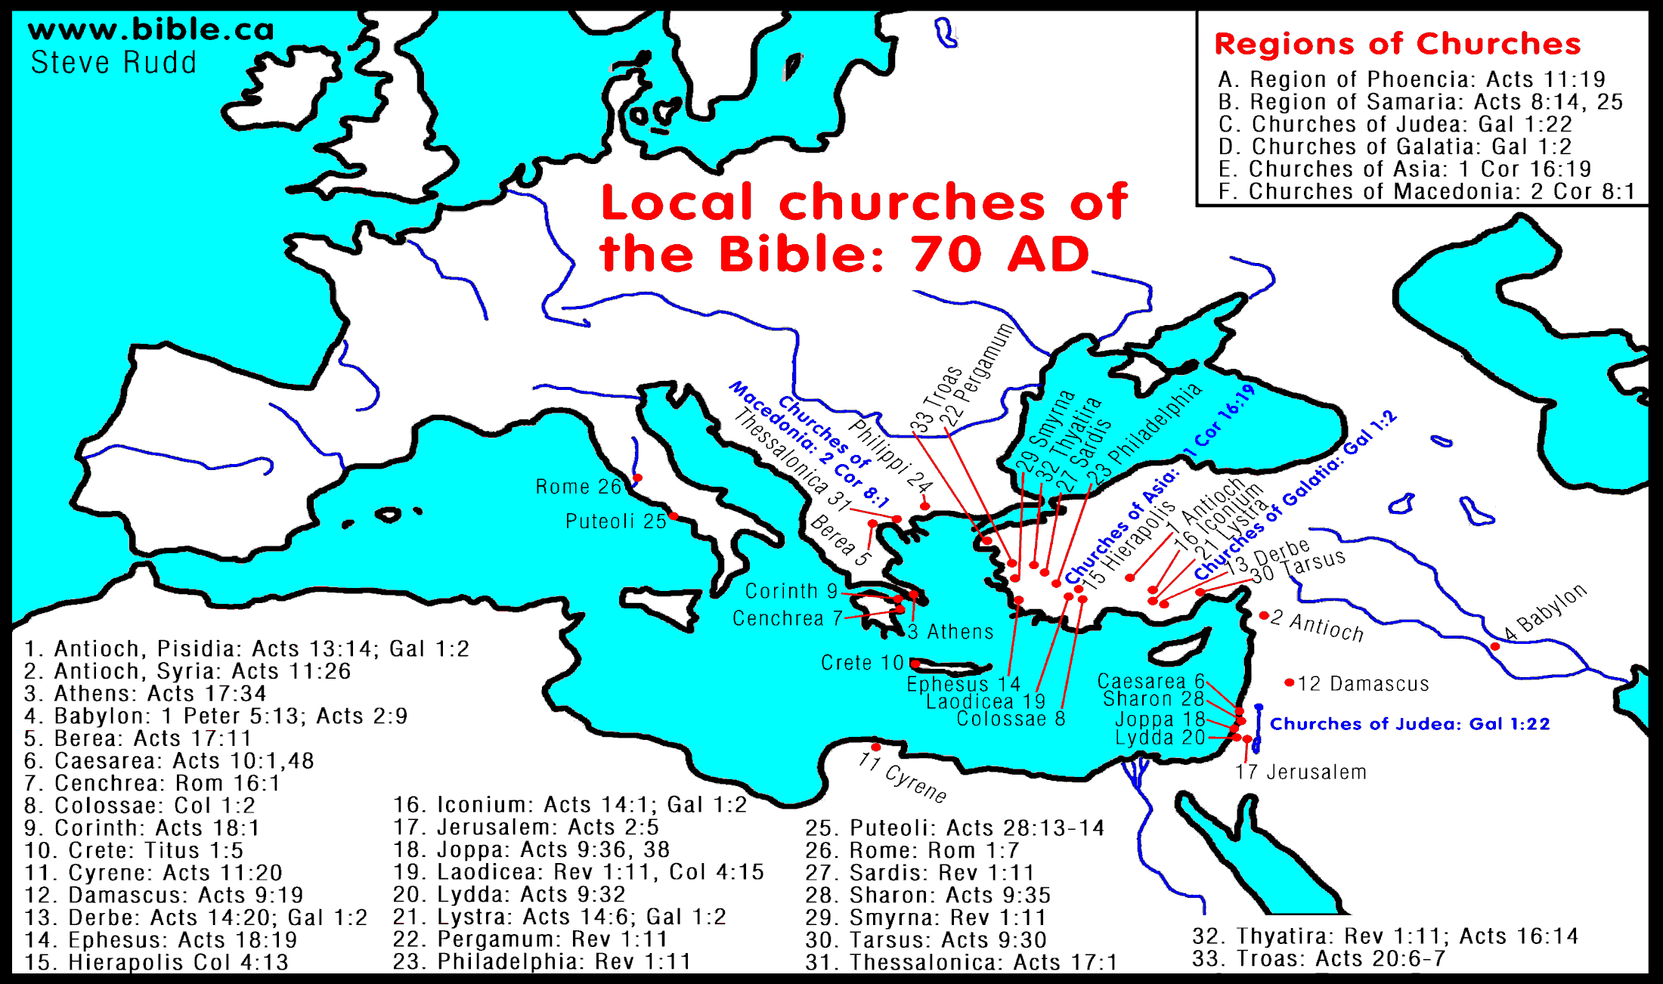
Sardis
One of the wealthiest cities in the world in the 6th century B.C.

Slide 3
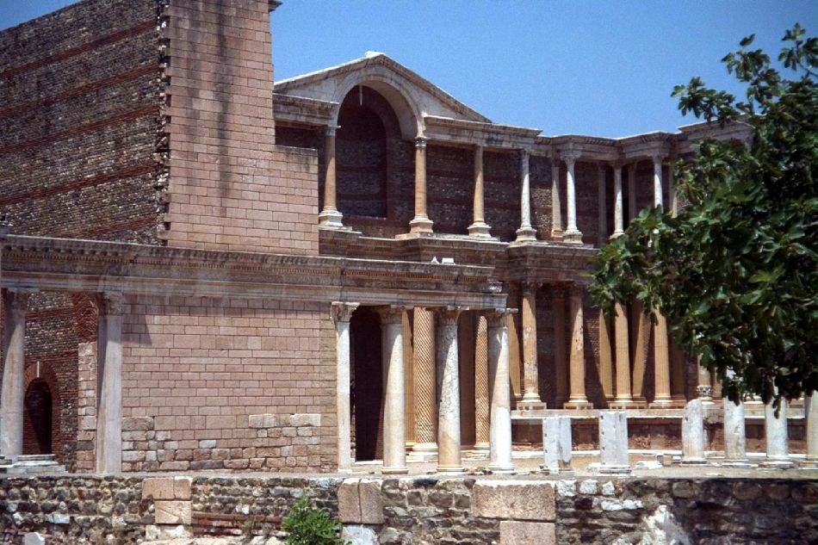
Sardis
Very Large Gymnasium
(www.holylandphotos.org)

Slide 4
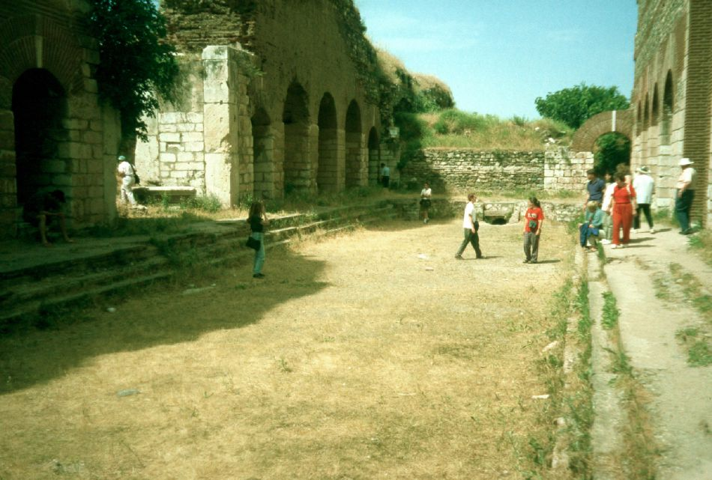
Sardis (gymnasium)
(www.holylandphotos.org)

Slide 5
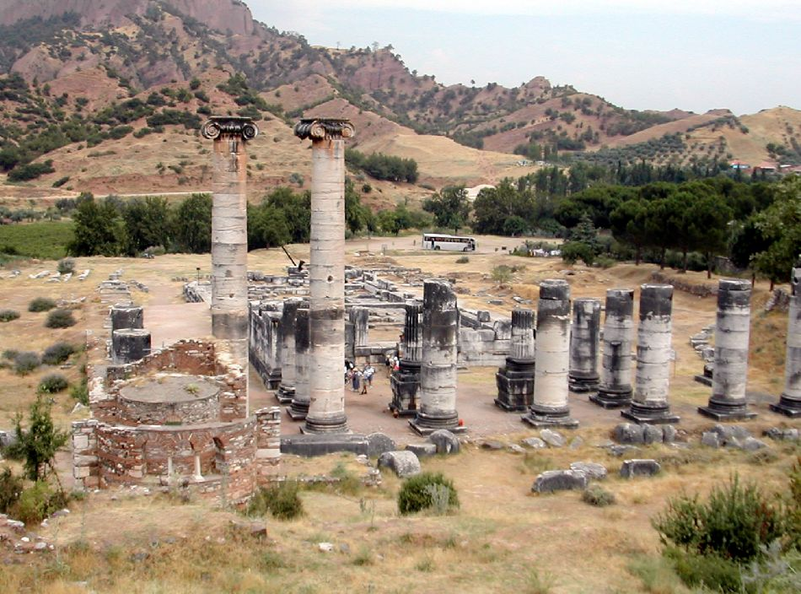
Sardis
Temple of Artemis (Diana)
(www.holylandphotos.org)

Slide 6
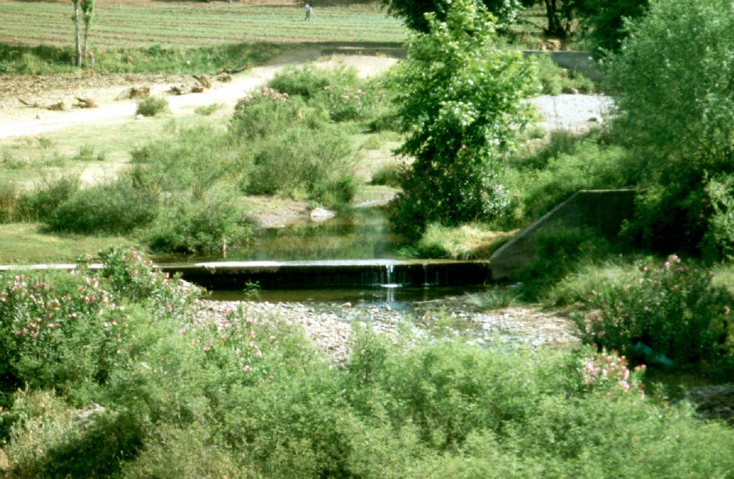
Sardis (Pactolus River)
Historical Note: Sardis is the birthplace of modern money (coinage)
(www.holylandphotos.org)

Slide 7
To the church at Sardis
Salutation (3:1a)
has 7 Spirits. . .figurative for Holy Spirit.
Spirit fully involved in Jesus’ work
“However, when He, the Spirit of truth, has come, He will guide you into all truth; for He will not speak on His own authority, but whatever He hears He will speak; and He will tell you things to come. He will glorify Me, for He will take of what is Mine and declare it to you” (Jn. 16:13, 14).
has 7 stars. . .the messengers to each church

Slide 8
To the church at Sardis
Divine Protest (3:1b)
name of being alive but really dead
reputation of being alive, but now dead
once dead but made alive (Eph. 2:1, 5)
now dead again (Jude 1:12)
Deadness:
faith without works (Jas. 2:26)
works without faith (Heb. 9:14; Rom. 6:11-13, 16, 18-21)

Slide 9
OBSERVATION:
The size of membership, the largeness of the building and the dynamics of a preacher do not make a church alive in the sight of Jesus!

Slide 10
To the church at Sardis
Divine Prescription/Warning (3:2, 3)
be watchful
strengthen the things that remain
remember how you received and heard
“Therefore we must give the more earnest heed to the things we have heard, lest we drift away” (Heb. 2:1).

Slide 11
To the church at Sardis
Divine Prescription/Warning
hold fast, “O Timothy! Guard what was committed to your trust. . .” (1 Tim. 6:20).
repent
Jesus will come as a thief (cf. 2:5)

Slide 12
To the church at Sardis
Divine Praise (3:4a)
a few names who have not defiled their garments
while Jesus makes a judgment against a church, he recognizes those individuals who remain pure
a weak congregation may have a few strong
a strong congregation may have a few weak
How would the “few” in Sardis keep their garments undefiled?

Slide 13
To the church at Sardis
Divine Promise/Invitation (3:4b-6)
the few will walk with Jesus in white (present fellowship will result in future fellowship in heaven)
he who overcomes:
shall be clothed in white garments
name will not be blotted out of Book of Life (cf. Ex. 32:32, 33; Ps. 69:28; Phil. 4:3)
confess name before Father and angels (Matt. 10:32; Lk. 12:8)

